Slide 1
数据仓库
数据可视化分析技术
Author：李凯
Time：2018年4月3日09:55:41

Slide 2
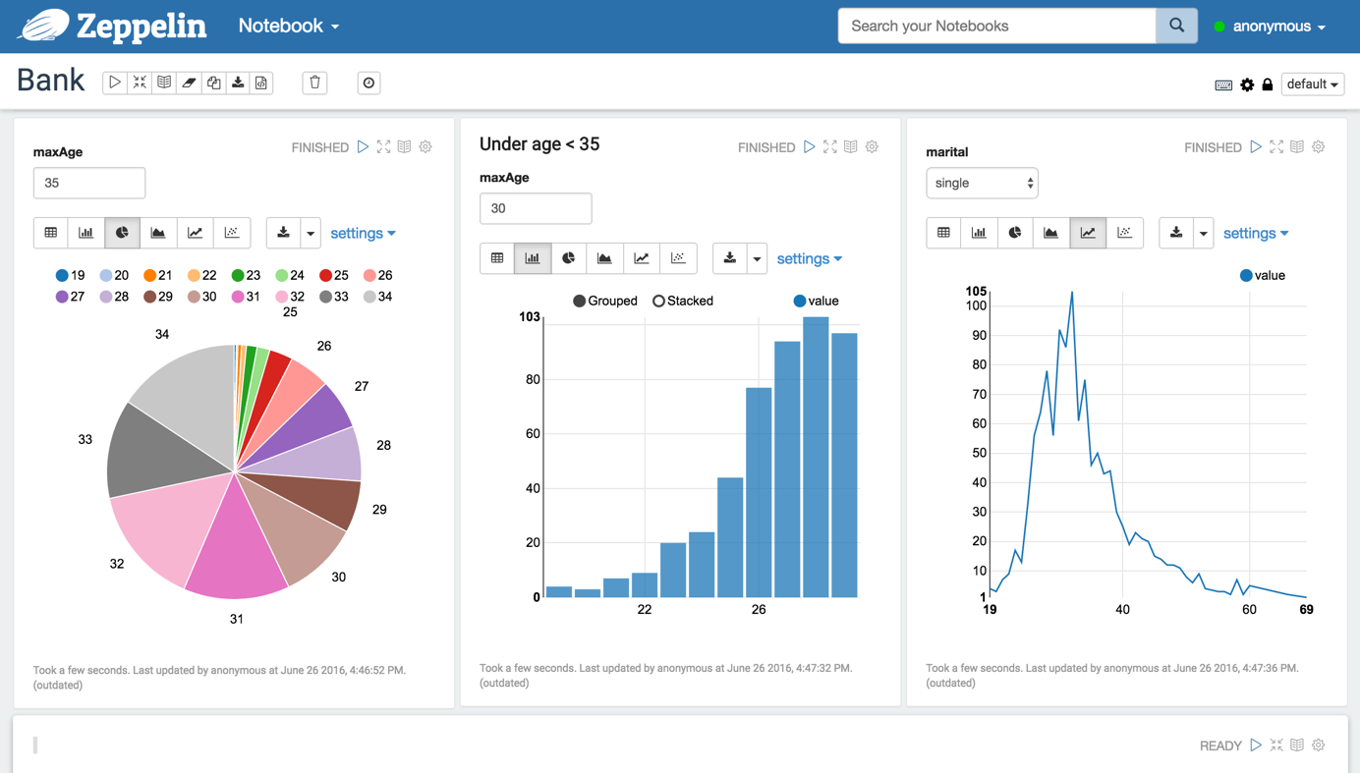
WHAT IS APACHE ZEPPELIN ?
多种用途的notebook，可以实现以下功能：
Data ingestion
Data discovery
Data analytics
Data Visualization & Collaboration

Slide 3
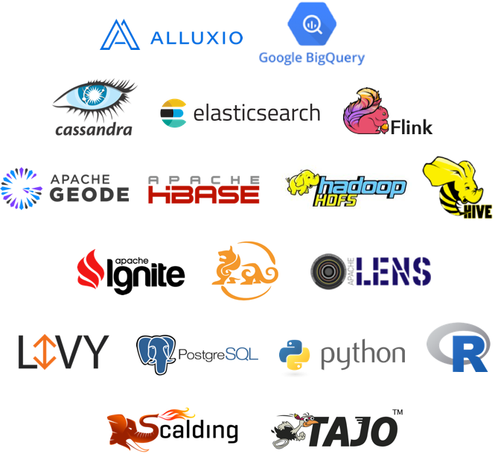
Multiple Language Backend
Apache Zeppelin interpreter concept allows any language/data-processing-backend to be plugged into Zeppelin. Currently Apache Zeppelin supports many interpreters such as Apache Spark, Python, JDBC, Markdown and Shell.
Apache Spark integration
Especially, Apache Zeppelin provides built-in Apache Spark integration. You don't need to build a separate module, plugin or library for it.
Apache Zeppelin with Spark integration provides
Automatic SparkContext and SQLContext injection
Runtime jar dependency loading from local filesystem or maven repository. Learn more about dependency loader.
Canceling job and displaying its progress

Slide 4
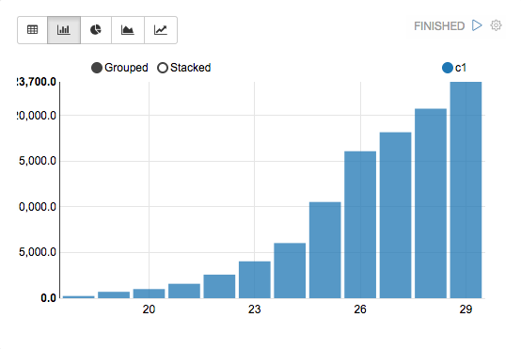
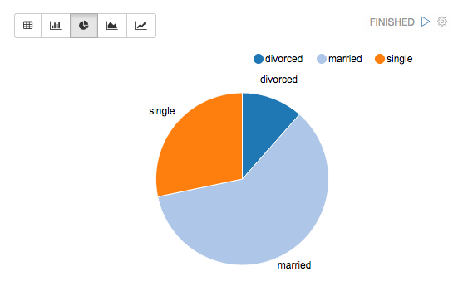
Data visualization
Some basic charts（表数据、柱状图、折线图、饼图） are already included in Apache Zeppelin. Visualizations are not limited to SparkSQL query, any output from any language backend can be recognized and visualized.

Slide 5
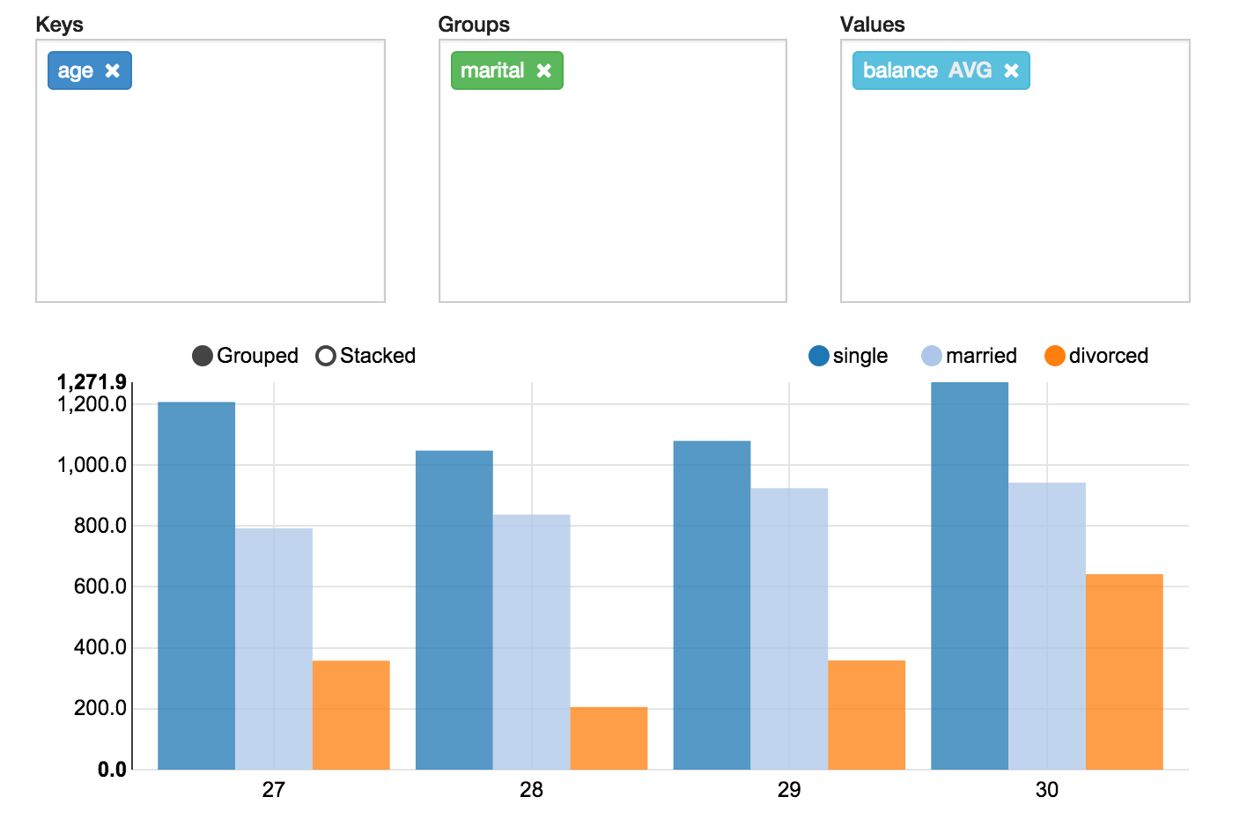
Pivot chart
Apache Zeppelin aggregates values and displays them in pivot chart with simple drag and drop. You can easily create chart with multiple aggregated values including sum, count, average, min, max.

Slide 6
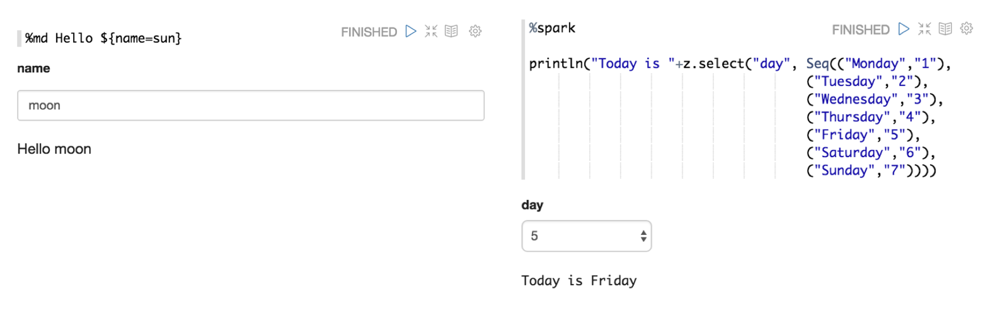
Dynamic forms
Apache Zeppelin can dynamically create some input forms in your notebook.

Slide 7
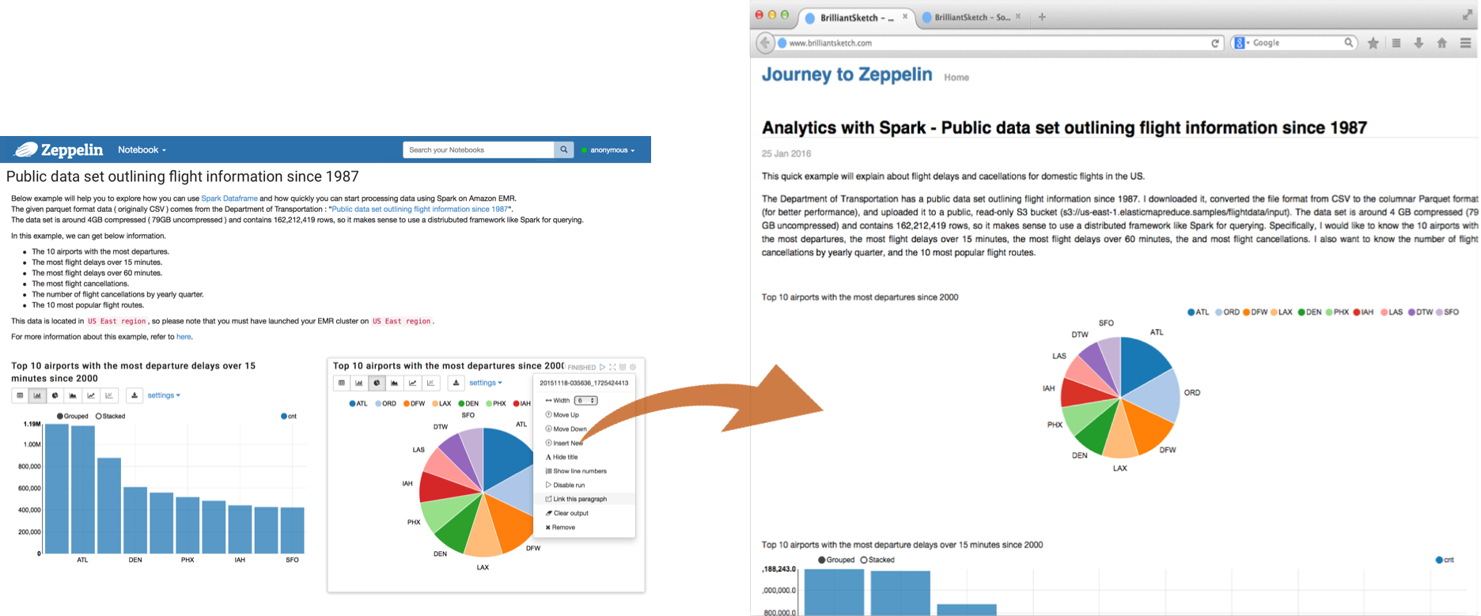
Collaborate by sharing your Notebook & Paragraph
Your notebook URL can be shared among collaborators. Then Apache Zeppelin will broadcast any changes in realtime, just like the collaboration in Google docs.
Apache Zeppelin provides an URL to display the result only, that page does not include any menus and buttons inside of notebooks. You can easily embed it as an iframe inside of your website in this way.

Slide 8

100% Opensource

Slide 9
对比
R
Hue
Superset
Tableau

Slide 10


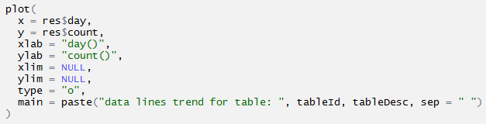
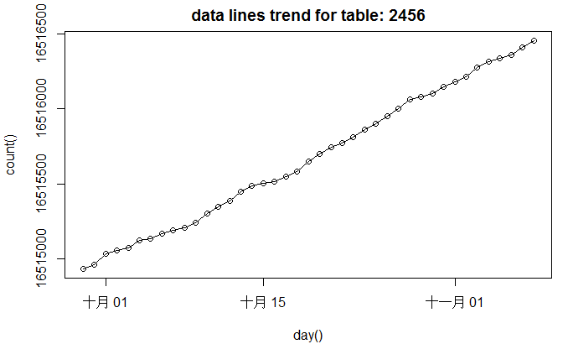

Slide 11
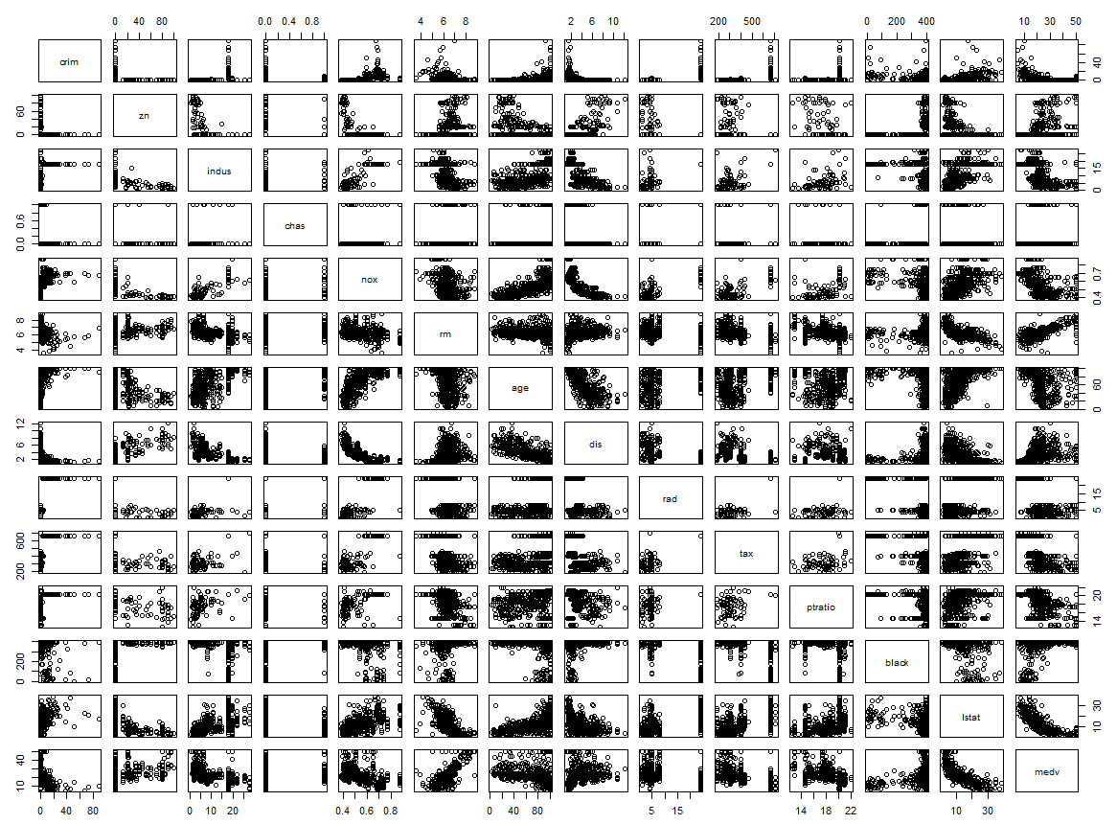
plot(Boston)

Slide 12
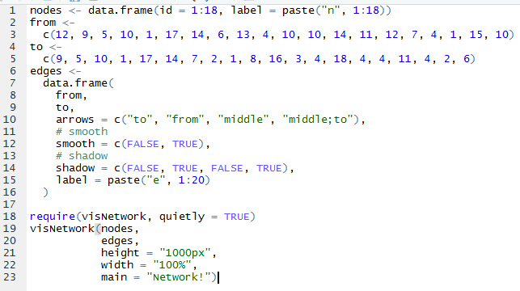
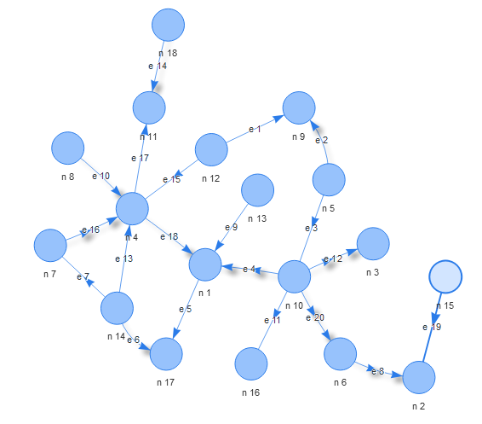

Slide 13
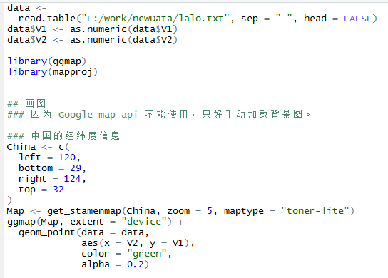
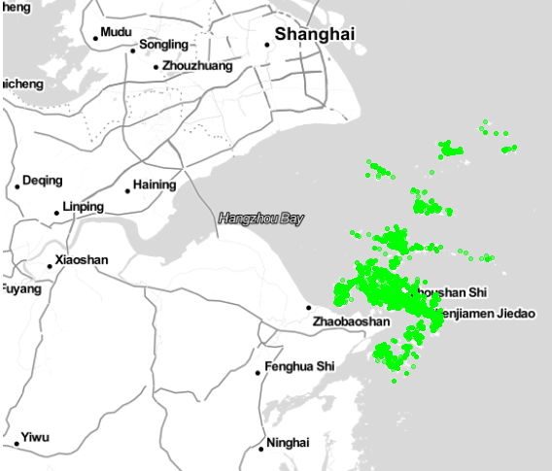

Slide 14
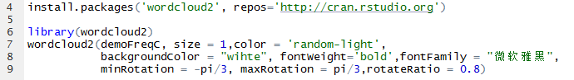


Slide 15
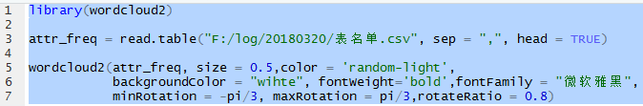
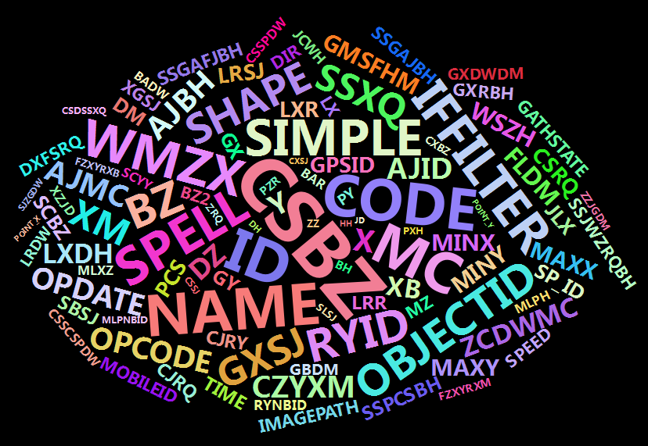

Slide 16

Make your data make an impact
Tableau helps the world’s largest organizations unleash the power of their most valuable assets: their data and their people.

Slide 17
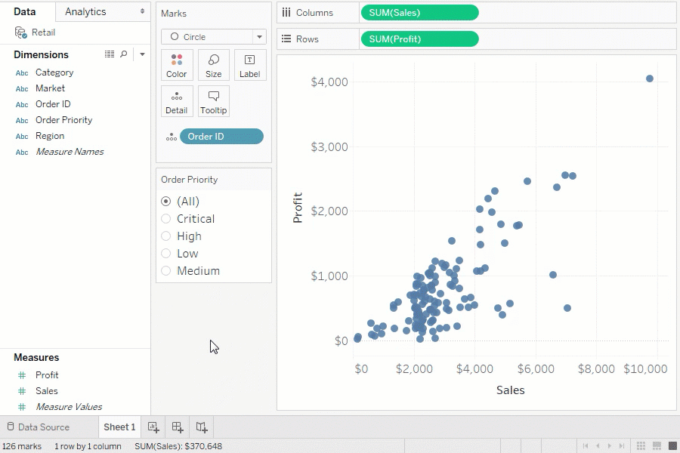
Answer deeper questions
Exceptional analytics demand more than a pretty dashboard. Quickly build powerful calculations from existing data, drag and drop reference lines and forecasts, and review statistical summaries. Make your point with trend analyses, regressions, and correlations for tried and true statistical understanding. Ask new questions, spot trends, identify opportunities, and make data-driven decisions with confidence.

Slide 18
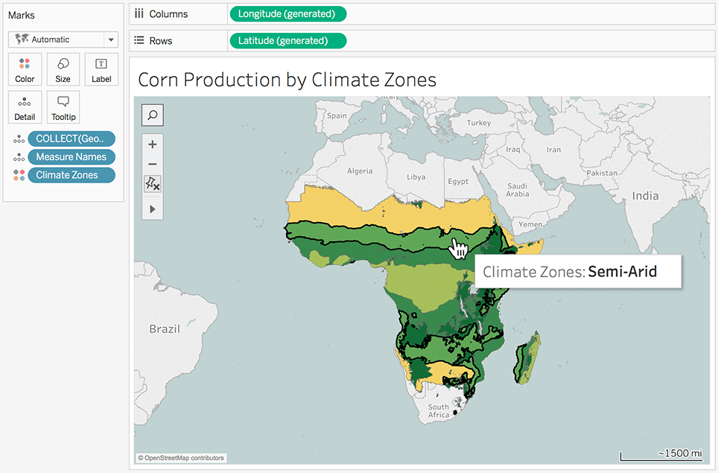
Put your data on the map
Answer the “where” as well as the “why.” Create interactive maps automatically. Built-in postal codes mean lightning-fast mapping for more than 50 countries worldwide. Use custom geocodes and territories for personalized regions, like sales areas. We designed Tableau maps specifically to help your data stand out.

Slide 19
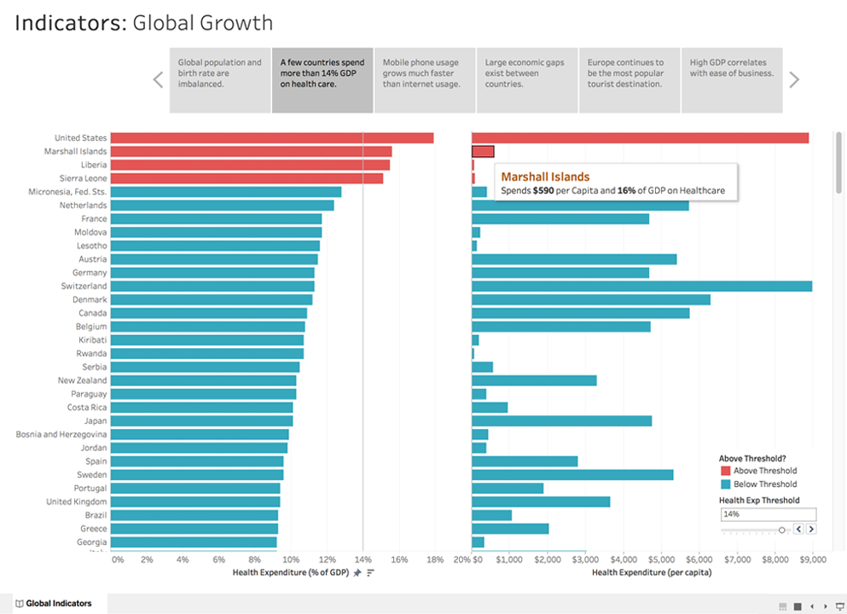
Let everyone in on it
Ditch the static slides for live stories that others can explore. Create a compelling narrative that empowers everyone you work with to ask their own questions, analyzing interactive visualizations with fresh data. Be part of a culture of data collaboration, extending the impact of your insights.

Slide 20
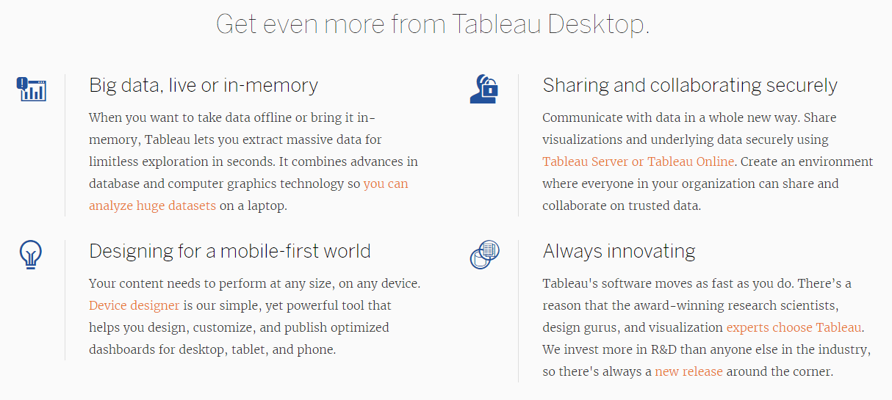

Slide 21

Apache superset
Apache Superset (incubating) is a modern, enterprise-ready business intelligence web application
Features
A rich set of data visualizations
An easy-to-use interface for exploring and visualizing data
Create and share dashboards
Enterprise-ready authentication with integration with major authentication providers (database, OpenID, LDAP, OAuth & REMOTE_USER through Flask AppBuilder)
An extensible, high-granularity security/permission model allowing intricate rules on who can access individual features and the dataset
A simple semantic layer, allowing users to control how data sources are displayed in the UI by defining which fields should show up in which drop-down and which aggregation and function metrics are made available to the user
Integration with most SQL-speaking RDBMS through SQLAlchemy
Deep integration with Druid.io

Slide 22
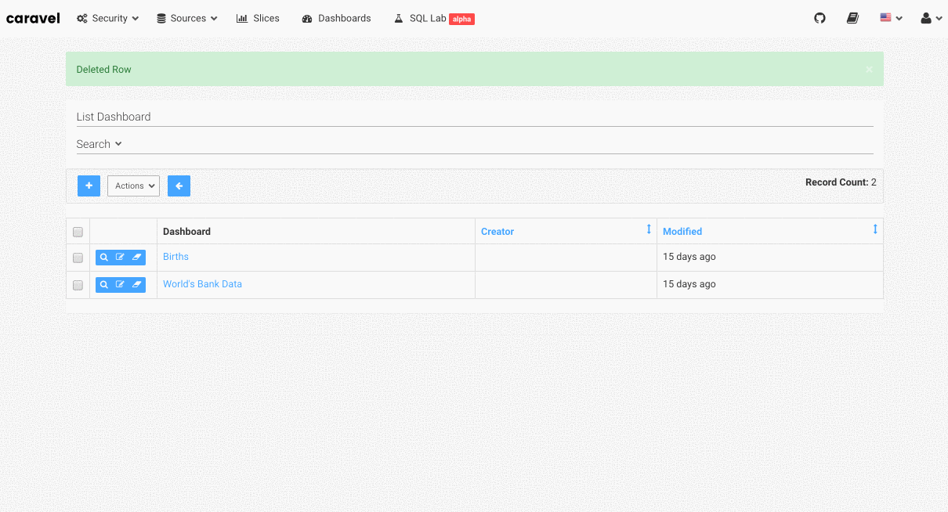

Slide 23
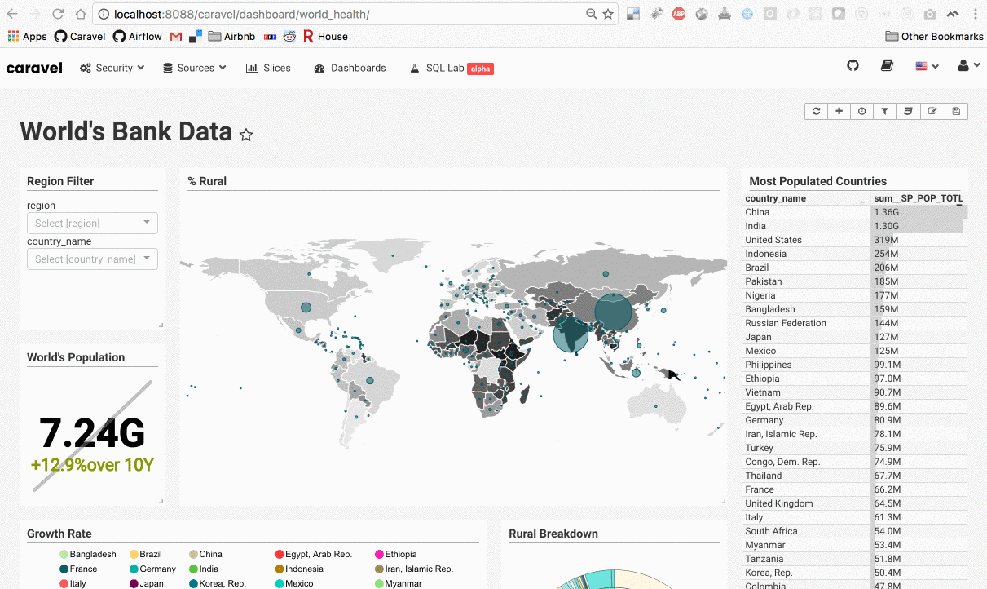

Slide 24
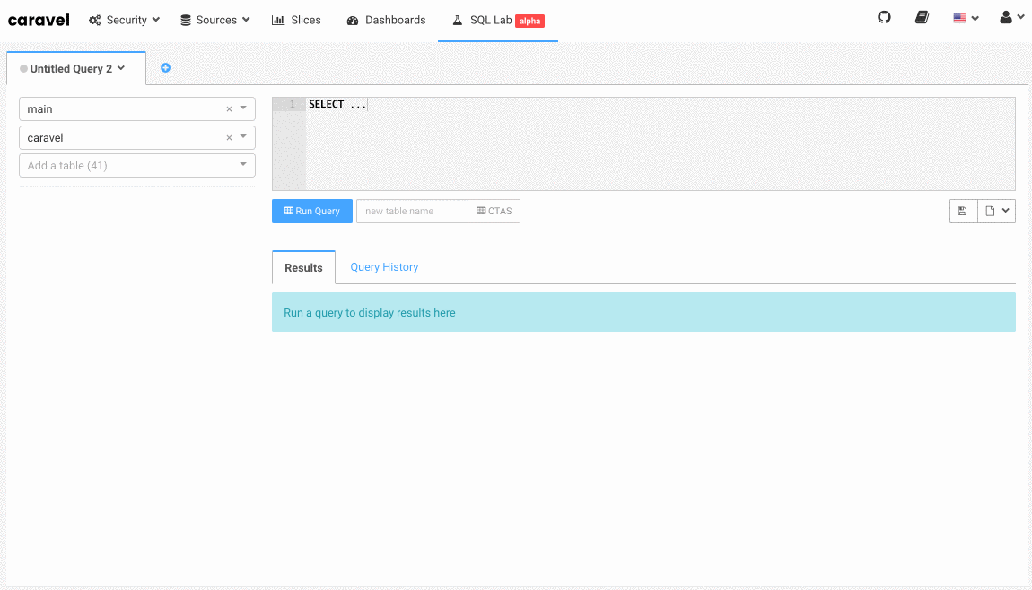

Slide 25
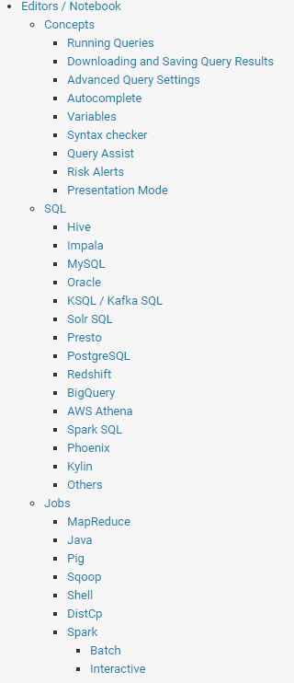
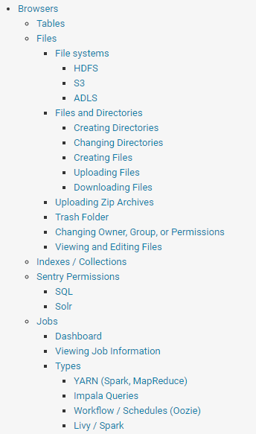
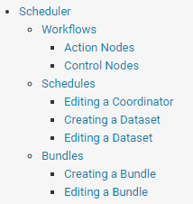
Query. Explore. Repeat.
Hue is an open source Analytics Workbench for self service BI

Slide 26
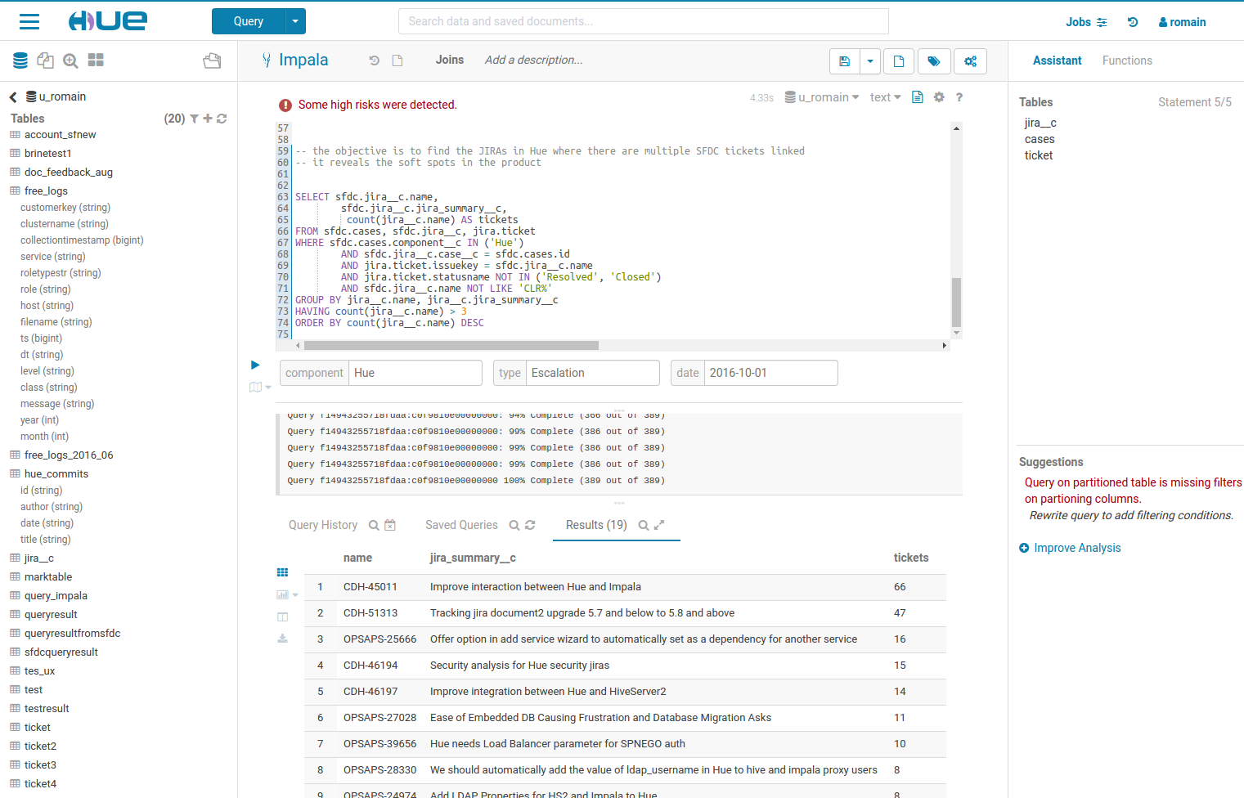
Editor
The goal of Hue’s Editor is to make data querying easy and productive.
It focuses on SQL but also supports job submissions. It comes with an intelligent autocomplete, search & tagging of data and query assistance.

Slide 27
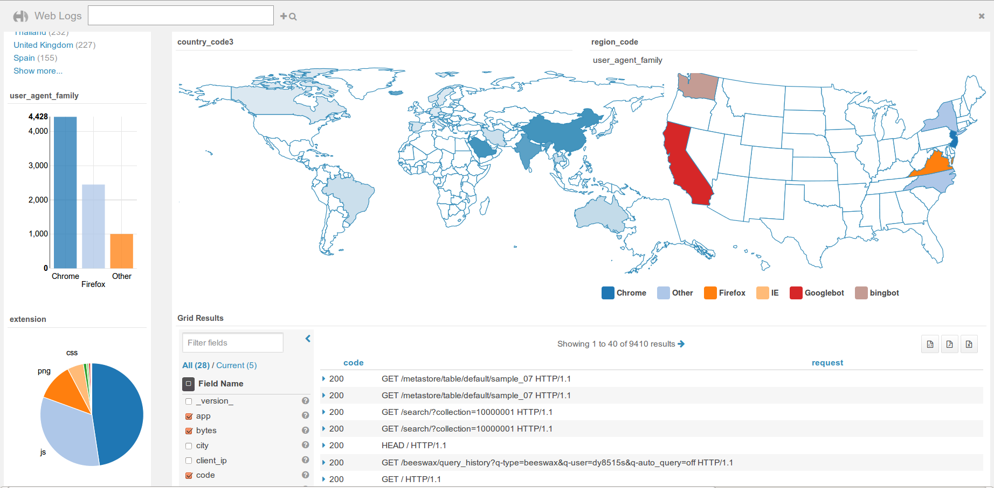
Dashboard
Dashboards are an interactive way to explore your data quickly and easily. No programming is required and the analysis is done by drag & drops and clicks.

Slide 28
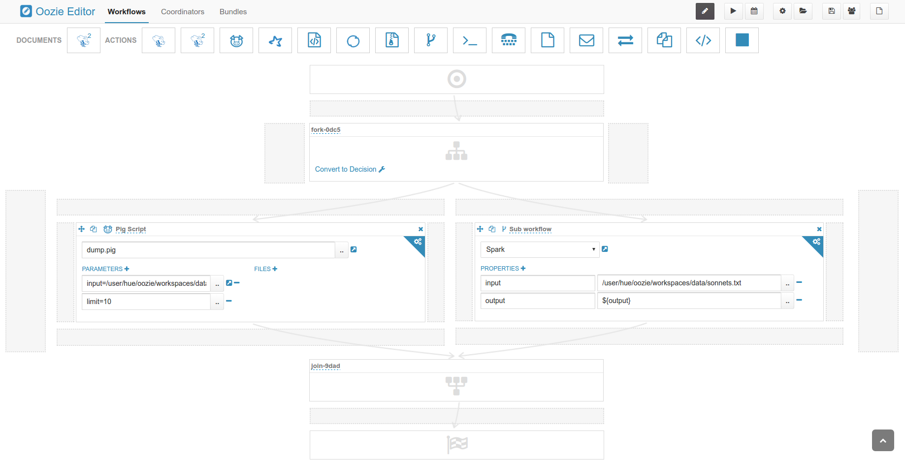
Scheduler
The application lets you build workflows and then schedule them to run regularly automatically. A monitoring interface shows the progress, logs and allow actions like pausing or stopping jobs.

Slide 29
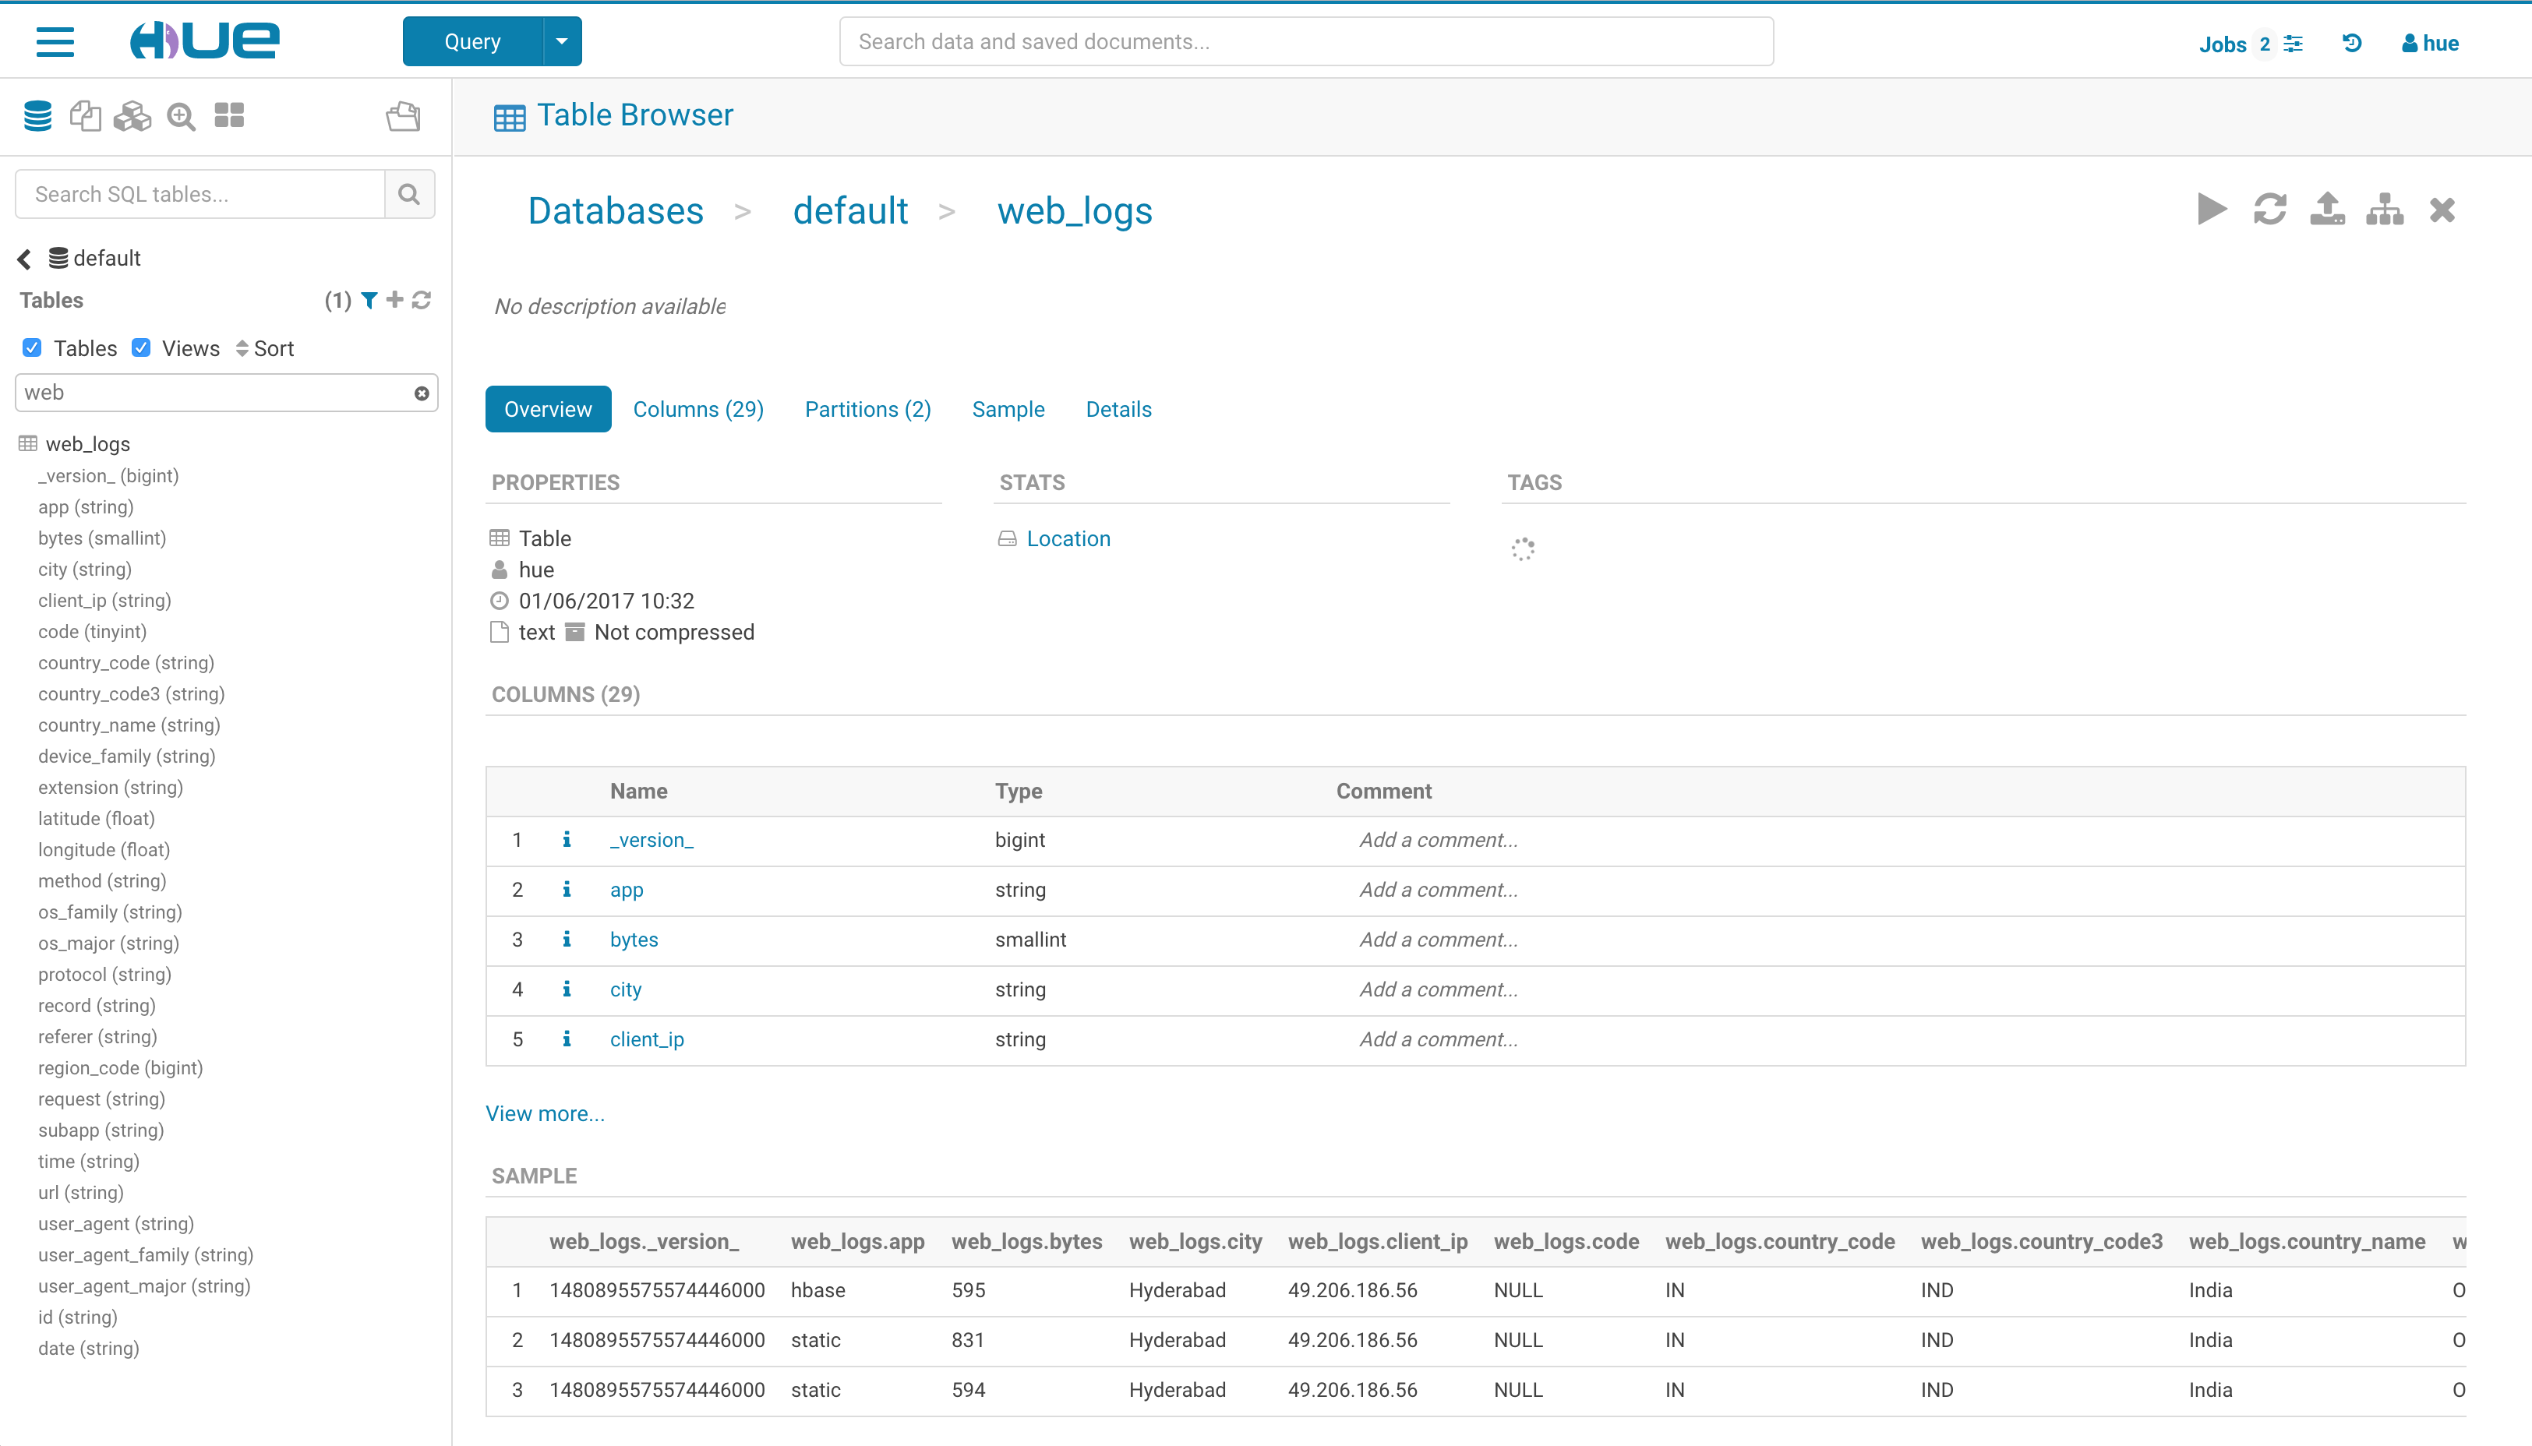
Browsers
Hue’s Browsers powers your Data Catalog. They let you easily search, glance and perform actions on data or jobs in Cloud or on premise clusters.

Slide 30
自主开发
要求开发一个展示报表的后台时，我最开始的做法是采用了最新的一些报表的图表的源码，比如echarts,结合springmvc+mybitis从数据库后台写前端需要的数据api。
缺点：针对业务场景，需要手动添加api接口，不方便，可操作性不强。 优点：按照echarts提供的前端图表，可以定制十分酷炫的图表展示形式。
接触到的Bi商业工具
腾讯云商业智能分析Bi：支持元数据管理，数据库中表可以直接拖拽，无需写sql语句。
网易有数
海致BDP
FineBI：可以直接下载软件到客户端，支持多平台。
缺点：上述平台除了FineBI，都是需要付费才能使用扩展功能的。 优点：定制化功能强大，元数据维护方便，图表展示形式丰富。操作难度低。

Slide 31
开源免费BI框架Zeppelin和Hue
Apache Zeppelin是一个提供了web版的类似ipython的notebook，用于做数据分析和可视化。背后可以接入不同的数据处理引擎，包括spark, hive, tajo等，原生支持scala, java, shell, markdown等。它的整体展现和使用形式和Databricks Cloud是一样的，就是来自于当时的demo。
Hue是一个开源的Apache Hadoop UI系统，最早是由Cloudera Desktop演化而来，由Cloudera贡献给开源社区，它是基于Python Web框架Django实现的。通过使用Hue我们可以在浏览器端的Web控制台上与Hadoop集群进行交互来分析处理数据，例如操作HDFS上的数据，运行MapReduce Job等等。
Superset 是 Airbnb 开源的大数据可视化平台。几乎所有主流的数据库；丰富的可视化展示，支持自定义创建 dashboard，可分享；深度集成 Druid.io（一种典型的数据立方）

Slide 32
 | zeppelin | R | hue | superset | tableau
主要功能 | 一个基于web的笔记本，支持交互式数据分析。你可以用SQL、Scala等做出数据驱动的、交互、协作的文档。(类似于ipython notebook，可以直接在浏览器中写代码、笔记并共享) | R语言，一种自由软件编程语言与操作环境，主要用于统计分析、绘图、数据挖掘。R内置多种统计学及数字分析功能。R的功能能够通过由用户撰写的包增强。 | 1. edittor 2. schedule 3. browser | 满足企业内部不同部门对数据的要求：老板、运营、产品、商务 细粒度的权限划分和控制，可满足不同层级的人员的不同权限 支持各种主流数据库，hbase、mysql、postgres等 不同数据不同维度的可视化 自定义数据的展示和可视化 | 轻点几下鼠标，就可连接到各类数据源，然后只需用拖放的方式就可快速地创建出交互、美观、智能的视图和仪表盘。任何Excel用户都能很容易的使用Tableau Desktop，它的速度超出你的想象，可能是现在你所用工具的十倍到一百倍。
亮点 | 1. 深度结合spark 2. notebook 3. 多语言 | 绘图功能，绝大部分统计学习算法 | browser、schedule | 支持绝大部分（关系）数据库、图表丰富 | 商业
不足 | 图表相对缺陷，但可以通过R改善 | 并行化不够、可视化依赖代码 | 侧重hadoop生态圈可视化； | 大数据支持不够 | 商业

Slide 33
Q&A 反馈
thanks for watching, see you next time

